Slide 1
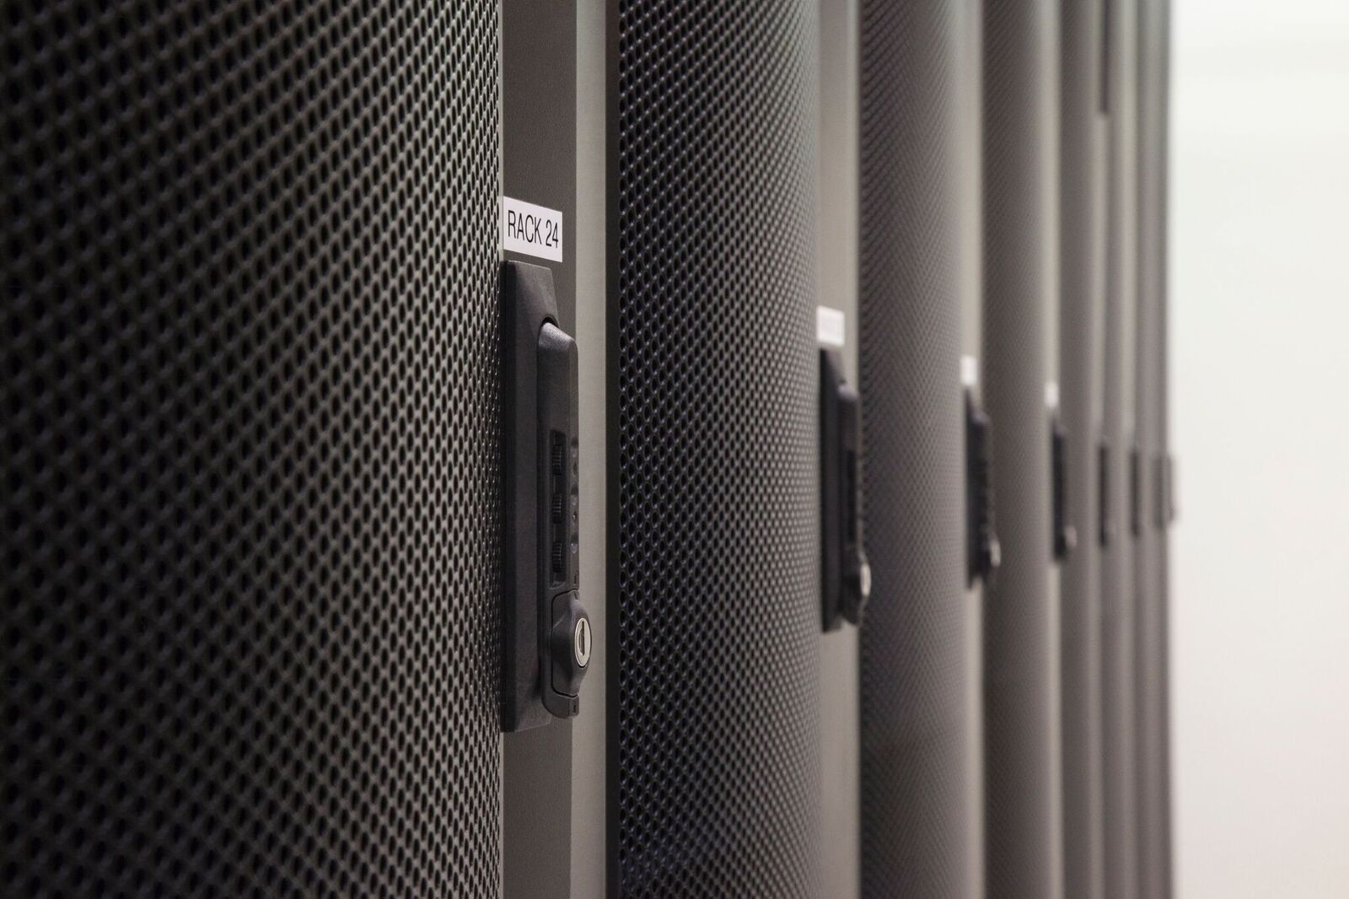
DCA Suite 2018.08 Shared Demo Lab Enablement – Level 340
Hayden Brown
DCA Suite Demo and Enablement
August 29, 2018
Version: 2
Notes:
Version 4
July 14, 2018
Updated By: Hayden Brown
hayden.brown@microfocus.com

Slide 2
Agenda
Requesting a demo
What is NEW in the DCA Suite 2018.08 Shared Demo lab
DCA Lab Infrastructure
Access the Lab Environment using the dca-clientapps RDP server
What is on your Desktop?
Using the Shared Demo Lab vCenter vSphere Client
DCA Suite Demo Use Cases:
  Provisioning, Patch, and running Compliance with DCA Suite 2018.08
  DMA 10.60 Ultimate Deployments and what is available to you
Troubleshooting Resources
Questions

Slide 3
Requesting a demo

Slide 4
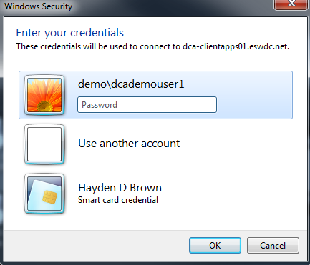
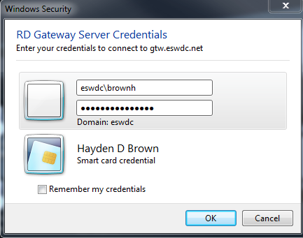
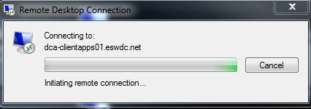
Access to DCA Shared Demo Lab Environment
Currently we do not have a reservation system for the DCA Shared Demo Lab Environment. It is based on need and customer demo requirements. Shortly we will be using Blueshift for calendar scheduling and auto reservation.
For now, all requests for access should be made via email to: hayden.brown@microfocus.com
All Demo Users will be required to have an eswdc account. Upon confirmation of reservation, credentials for the environment will be granted. Steps to login are:
1) Access RD Gateway server using eswdc account 2) Provide demo\dcademouserX credentials

Slide 5
What is NEW with DCA Suite Shared Demo Lab Environment?

Slide 6

What is new in the DCA Suite 2018.08 Shared Demo Lab
Updated versions: DCA Suite 2018.08 Premium and DMA 10.60 Ultimate
Simply to login and use
Simulate a real data center
  More resources and types of resources
Integrated SA, DMA Ultimate, Puppet, VM vCenter
Full vCenter access for target server reverts and booting control.
Faster!
  Faster to demo
      Faster to revert and re-demo
        Just plain FASTER!
Installed in the lab on August 23, 2018

Slide 7
Data Center Automation Suite 2018.08
DCA performs compliance, patching, and provisioning on OS, DB, and MW. DCA can manage agentless, or agent based resources including Puppet managed nodes.
In this Lab environment we will be using the UI to perform compliance audit and remediation of RHEL OS and ORACLE DB on SA agent resources.
Perform both static and dynamic patching of RHEL servers
You can also run compliance audit and remediation on Windows servers as well.
We have integrated Puppet Server and two Puppet nodes for compliance scanning only!

Slide 8
DCA Lab Infrastructure

Slide 9
Data Center Automation – Foundation
Integrations
Server Automaton (SA)
Core - Container Deployment Foundation
Mgmt-Portal
Cluster admin
PG DB
(HA)
PG Pool
(HA)
NGINX
Vault
IDM
Core Ingress
Puppet
Suite – Deployment
NGINX
Deployment admin
DCA Ingress
Distr. Cfg Store
(Zookeeper)
License Server (AutoPass)
Postgres Admin
Message Bus
(Kafka HA)
Capability 1
External:
Capability 2
Capability 3
Analytic DB (Vertica)
Capability 4
Capability 5
Analytic DB (Vertica)
uCMDB
Operations Orchestration
Reporting
(OBR)
Kubernetes, Docker, ETCD
Micro Focus Confidential

Slide 10
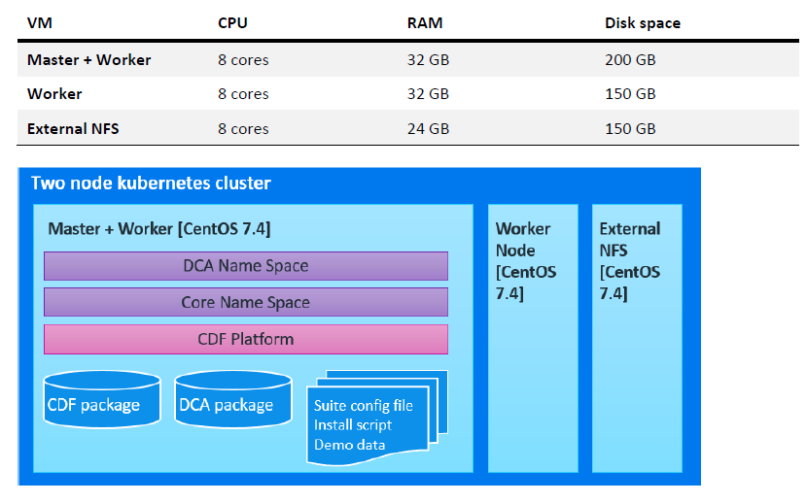
Typical “Demo/POC” DCA Suite 2018.08 installation

Slide 11
Lab infrastructure
Full SA 10.60 with patch SRVA_0245
  OS provisioning: RHEL, SUSE, Ubuntu, CentOS, W2K8R2, W2K12R2, W2K16
  Patching RHEL 7, Windows 2008R2, 2012R2
  OS Compliance – Full set from Marketplace
  Software policies for Linux and Windows applications
DMA 10.60 Ultimate (Note: Still only 10.50 content)
  Oracle provision, DB create, patching, rollback for 11G and 12C
  MS SQL provision, DB create, patching, rollback for 2008R2 and 2012
  MySQL provision
  JBOSS provision software
DCA Suite 2018.08 Premium
  Provisioning, Patching (RHEL), and Compliance (OS and Oracle)
vCenter 6.0 under SA 10.60 management for provisioning vms using OSBP and full SA feature set.

Slide 12
DCA Shared Demo Lab Configuration
Tasks which can be done in the Shared Demo DCA Suite 2018.08
Provision through SA Linux and Windows servers
  Complete through SA full OSBP or
  Bring into OSBP Maintenance mode and complete provisioning from DCA
Use DMA 10.60 Ultimate to provision/Patch Oracle 12C and Database, MS SQL, or provision JBOSS
Created a RHEL resource group and added the RHEL Servers to the Group
  Add PCI/CIS Policy and Maintenance Schedule
Ran Discovery on the RHEL Servers to discover the ORACLE DBs
Run compliance on Windows, RHEL, CentOS, and Oracle Servers.
Create Policy for RHEL Patching
  Add Meltdown and Spectre Benchmarks (Patching)
Attach Patch Policy to RHEL Resource group and scan/remediate patches

Slide 13

New DCA Suite 2018.08 Shared Lab Environment
SA 10.60 Ultimate
sa1060.dca.demo.local
172.16.239.20
Puppet Master
puppet-server.dca.demo.local
172.16.239.70
RHEL 7 Patch Repo
rh-repo.dca.demo.local
172.16.239.30
WSUS Server
wsus.dca.demo.local
172.16.239.31
OBR 10.31
obr.dca.demo.local
172.16.239.21
DMA Ultimate 10.60
dma.dca.demo.local
172.16.239.22
DNS – DHCP - AD
dns.demo.local
172.16.239.9
AccessVM
dca-clientapps01.eswdc.net
172.16.239.1
Future
SA 10.60 managed
vCenter 6.0
DCA Suite
Version 2018.08
Servers under SA/DCA CDF management
Puppet managed
DCA Suite 2018.05 Demo Appliance
Windows
2012 R2 64 Bit
vcenter-5-5
172.16.239.13
SA - Red Hat Servers
demo1ms5 | 172.16.239.55
demo2ms5 | 172.16.239.65
demo3ms5 | 172.16.239.75
demo4ms5 | 172.16.239.85
Agentless - Red Hat Servers
demo1ms6 | 172.16.239.56
demo2ms6 | 172.16.239.66
demo3ms6 | 172.16.239.76
demo4ms6 | 172.16.239.86
SA -Windows Servers
demo1ms9 | 172.16.239.56
demo2ms9 | 172.16.239.66
demo3ms9 | 172.16.239.76
demo4ms9 | 172.16.239.86
Agentless - Windows Servers
demo1ms3 | 172.16.239.55
demo2ms3 | 172.16.239.65
demo3ms3 | 172.16.239.75
demo4ms3 | 172.16.239.85
Puppet CentOS Servers
demo1puppet1 | 172.16.239.51
demo2puppet1 | 172.16.239.61
demo3puppet1 | 172.16.239.71
demo4puppet1 | 172.16.239.81
Puppet RHEL Servers
demo1puppet2 | 172.16.239.52
demo2puppet2 | 172.16.239.62
demo3puppet2 | 172.16.239.72
demo4puppet2 | 172.16.239.82
CentOS
7.3 64 Bit
demo-mast
172.16.239.40
CentOS
7.3 64 Bit
dca-mast
172.16.239.23
A
VMWARE ESXi
Virtual
16 GB RAM
172.16.239.3
CentOS
7.3 64 Bit
dca-wkr
172.16.239.24
CentOS
7.3 64 Bit
demo-wkr
172.16.239.41
253
GB
CentOS
7.3 64 Bit
demo-nfs
172.16.239.42
VMWARE ESXi
Virtual
16 GB RAM
172.16.239.4
CentOS
7.3 64 Bit
dca-nfs
172.16.239.25
SA Provisioning with MBC – Linux Servers
demo1ms8p | 172.16.239.58
demo2ms8p | 172.16.239.68
demo3ms8p | 172.16.239.78
demo4ms8p | 172.16.239.88
253
GB
Domain: dca.demo.local Gateway: 172.16.239.1 Proxy: proxy.eswdc.net:8088 (156.152.46.12)

Slide 14
Example: Resources for demo2user – What you can use
SA 10.60 Ultimate
sa1060.dca.demo.local
172.16.239.20
Puppet Master
puppet-server.dca.demo.local
172.16.239.70
RHEL 7 Patch Repo
rh-repo.dca.demo.local
172.16.239.30
WSUS Server
wsus.dca.demo.local
172.16.239.31
OBR 10.31
obr.dca.demo.local
172.16.239.21
DMA Ultimate 10.60
dma.dca.demo.local
172.16.239.22
DNS – DHCP - AD
dns.demo.local
172.16.239.9
AccessVM
dca-clientapps01.eswdc.net
172.16.239.1
Future
SA 10.60 managed
vCenter 6.0
DCA Suite
Version 2018.08
Servers under SA/DCA CDF management
Puppet managed
DCA Suite 2018.05 Demo Appliance
Windows
2012 R2 64 Bit
vcenter-5-5
172.16.239.13
SA - Red Hat Servers
demo1ms5 | 172.16.239.55
demo2ms5 | 172.16.239.65
demo3ms5 | 172.16.239.75
demo4ms5 | 172.16.239.85
Agentless - Red Hat Servers
demo1ms6 | 172.16.239.56
demo2ms6 | 172.16.239.66
demo3ms6 | 172.16.239.76
demo4ms6 | 172.16.239.86
SA -Windows Servers
demo1ms9 | 172.16.239.56
demo2ms9 | 172.16.239.66
demo3ms9 | 172.16.239.76
demo4ms9 | 172.16.239.86
Agentless - Windows Servers
demo1ms3 | 172.16.239.55
demo2ms3 | 172.16.239.65
demo3ms3 | 172.16.239.75
demo4ms3 | 172.16.239.85
Puppet CentOS Servers
demo1puppet1 | 172.16.239.51
demo2puppet1 | 172.16.239.61
demo3puppet1 | 172.16.239.71
demo4puppet1 | 172.16.239.81
Puppet RHEL Servers
demo1puppet2 | 172.16.239.52
demo2puppet2 | 172.16.239.62
demo3puppet2 | 172.16.239.72
demo4puppet2 | 172.16.239.82
CentOS
7.3 64 Bit
demo-mast
172.16.239.40
CentOS
7.3 64 Bit
dca-mast
172.16.239.23
A
VMWARE ESXi
Virtual
16 GB RAM
172.16.239.3
CentOS
7.3 64 Bit
dca-wkr
172.16.239.24
CentOS
7.3 64 Bit
demo-wkr
172.16.239.41
253
GB
CentOS
7.3 64 Bit
demo-nfs
172.16.239.42
VMWARE ESXi
Virtual
16 GB RAM
172.16.239.4
CentOS
7.3 64 Bit
dca-nfs
172.16.239.25
SA Provisioning with MBC – Linux Servers
demo1ms8p | 172.16.239.58
demo2ms8p | 172.16.239.68
demo3ms8p | 172.16.239.78
demo4ms8p | 172.16.239.88
253
GB
Domain: dca.demo.local Gateway: 172.16.239.1 Proxy: proxy.eswdc.net:8088 (156.152.46.12)

Slide 15
Lab Resources (Shared by all users)
Hostname | IP | OS | Network | CPU | Memory | Disk | Power
dca-clientapps01 | 172.16.239.10 | MS W2K8 64 Bit | DCA_Privnet1 | 4 | 24 GB | 40 GB | On
dns | 172.16.239.9 | MS W2K12R2 64 Bit | DCA_Privnet1 | 1 | 4 GB | 40 GB (thin) | On
sa1060 | 172.16.239.20 | Red Hat EL 7.3 64 Bit | DCA_Privnet1 | 8 | 24 GB | 600 GB (thin) | On
dma | 172.16.239.22 | Red Hat EL 7.3 64 Bit | DCA_Privnet1 | 8 | 16 GB | 40 GB (thin) | On
rh-repo | 172.16.239.30 | CentOS 7 64 Bit | DCA_Privnet1 | 4 | 8 GB | 100 GB (thin) | On
wsus | 172.16.239.31 | MS W2K12R2 64 Bit | Private
obr | 172.16.239.21 | Red Hat EL 7.3 64 Bit | DCA_Privnet1 | 8 | 16 GB | 40 GB (thin) | Off
puppet-server | 172.16.239.70 | CentOS 7 64 Bit | DCA_Privnet1 | 4 | 6 GB | 40 GB (thin) | On
ms1 | 172.16.239.111 | MS W2K8 R2 64 Bit | DCA_Privnet1 | 4 | 6 GB | 40 GB (thin) | On
ms5 | 172.16.239.115 | RedHat ES 6.4 64 Bit | DCA_Privnet1 | 8 | 6 GB | 40 GB (thin) | On
MSDB5 | 172.16.239.115 | Oracle 11.2.4 Database | This is installed on the Base 4 Snapshot, SA Agent
ms6 | 172.16.239.116 | RedHat ES 6.4 64 Bit | DCA_Privnet1 | 8 | 6 GB | 40 GB (thin) | On
MS6DB1 | 172.16.239.116 | Oracle 11.2.4 Database | This is installed on the Base 4 Snapshot, SA Agent
Domain: dca.demo.local Gateway: 172.16.239.1 Proxy: proxy.eswdc.net:8088 (156.152.46.12)

Slide 16
Lab Resources – DCA Demo Appliance (Shared by all users)
Hostname | IP | OS | Network | CPU | Memory | Disk | Power
This is the DCA Suite 2018.08 Premium install
dca-mast – CDF Master/Worker | 172.16.239.23 | CentOS 7.3 64 Bit | DCA_Privnet1 | 8 | 65 GB | 200 GB (thin) | On
dca-wkr – CDF Worker | 172.16.239.24 | CentOS 7.3 64 Bit | DCA_Privnet1 | 8 | 32 GB | 200 GB (thin) | On
dca-nfs – NFS Server | 172.16.239.25 | CentOS 7.3 64 Bit | DCA_Privnet1 | 8 | 24 GB | 200 GB (thin) | On
vcenter-6.0 | 172.16.239.13 | MS W2K12 R2 64 Bit | DCA_Privnet1 | 2 | 8 GB | 50 GB (thin) | On
This is the DCA Suite 2018.05 Demo Appliance It is used for looking at the demo data only! You cannot do any scans, or remediation with this environment. Demo Only!
demo-mast – CDF Master/Worker | 172.16.239.40 | CentOS 7.3 64 Bit | DCA_Privnet1 | 8 | 32 GB | 200 GB (thin) | On
demo-wkr – CDF Worker | 172.16.239.41 | CentOS 7.3 64 Bit | DCA_Privnet1 | 8 | 32 GB | 200 GB (thin) | On
demo-nfs – NFS Server | 172.16.239.42 | CentOS 7.3 64 Bit | DCA_Privnet1 | 8 | 24 GB | 200 GB (thin) | On
Domain: dca.demo.local Gateway: 172.16.239.1 Proxy: proxy.eswdc.net:8088 (156.152.46.12)

Slide 17
Passwords inside the Lab Environment
Account Type | User | Password | Permissions
Servers ms1,5,6,9, sa1060, dns, rh-repo, wsus,dma, puppet-server, demoXpuppetX | root/administrator | Automation123 | Server Admin
SA 10.60 – SA User | admin administrator1 demo1user/demo2user/demo3user/demo4user | Automation123 | SA Admin account Super Admin/Superuser Superusers (All permissions)
DMA 10.60 user | connector administrator1 demo1user/demo2user/demo3user/demo4user dmaadmin/dmaworkflow/dmarunner | Automation123 | DMA-SA Connector Account Superuser and DMA Admin DMA Users
dns – dns administrator | administrator | Automation123 | Administrator Modify services
DCA 2018.08 CDF | DCA UI – dcaadmin/demo1user/ demo2user/demo3user/demo4user DCA OO Central – oo_admin DCA IDM – admin DCA UCMDB – admin (use IE) | Automation.123 | Access to DCA CDF
DCA 2018.05 CDF – Demo Appliance (demo data) | DCA UI – dcaadmin DCA IDM – admin | 123.Automation | Access to DCA Demo Content

Slide 18
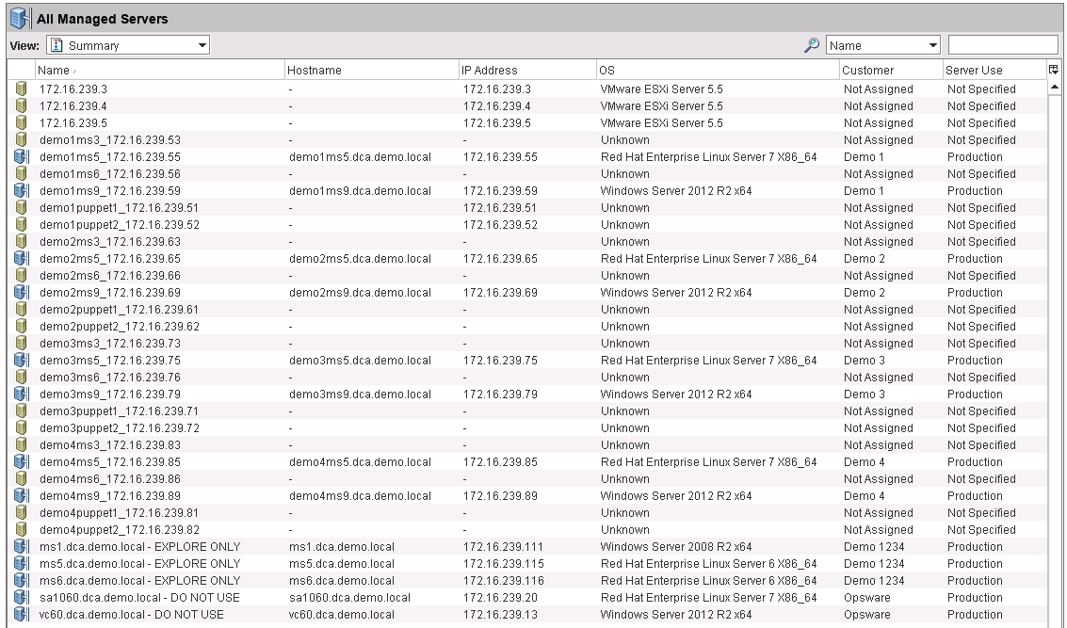
Your SA 10.60 will look like this
This is the base snapshot. We will not revert SA, unless it is having “technical difficulties”

Slide 19

Danger Danger Will Robinson!
What you can and cannot do in the lab!
DO
Create as many target vms as you need, but
Clean-up your unused vms.
Add content to SA, DMA, but label or locate in proper folders. Lab environment will be reverted from time-to-time.
If you have good content, let the DCA Enablement team know so we can back it up.
Prefix your DCA groups and policy names with your initials. Makes it easy to identify your content.
Always LOGOUT from the dca-clientapps server!
DO NOT!
Do not stop any of the services. Others may be using them.
Do not delete a server from SA without first removing it from your DCA Groups. You will end up with a corrupt folder. Need to use UCMDB to delete.
Do Not touch/delete or use any other demoXuser’s vms! Use ONLY your OWN!
Do not leave your demo reservation with the dca-clientapps server and your dcademouser account still logged in.

Slide 20
Login to dca-clientapps Accessvm RDP Session

Slide 21
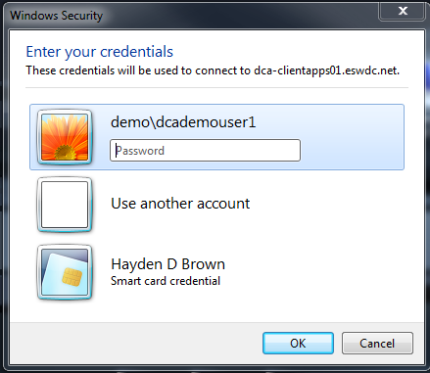
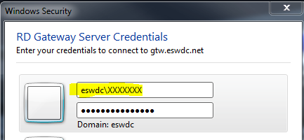
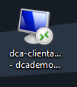
  Login to the Student’s Lab Accessvm RDP Session (1)
From the Internet or VPN, You can use the supplied RDP configuration file to access YOUR lab environment. Login using your eswdc credentials for Gateway.
Use your eswdc account and password for Gateway Server access
Once that security passed you will be prompted for the dcademouserX login
The dcademouserX account password will change. Check your reservation.

Slide 22
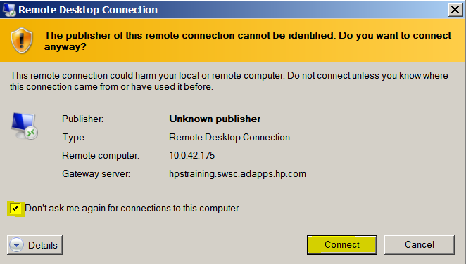
  Login to the Student’s Lab Accessvm RDP Session (2)
If Prompted: In the next window, click on Connect
Note: You can change the default to “Don’t ask me again for connections to this computer”

Slide 23
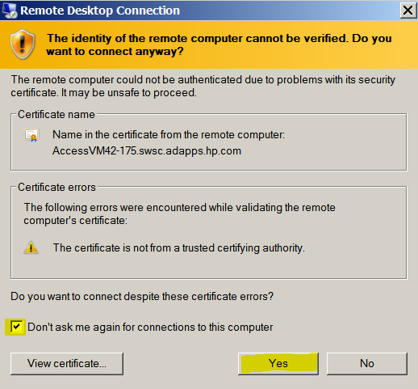
  Login to the Student’s Lab Accessvm RDP Session (3)
Click Yes for the security notice. The RDP session will now load your user settings into the accessvm.
Note: The login can take a few minutes! Be patient. Let it complete. Your session is not hung. This may happen every time you login.
Note: Sometimes the login will fail the first or second time. Please try at least three times. BUT make sure you type in the correct password! If you cut-n-paste do so from NotePad!
If you try several times with a wrong password you could be locked-out for several hours!

Slide 24
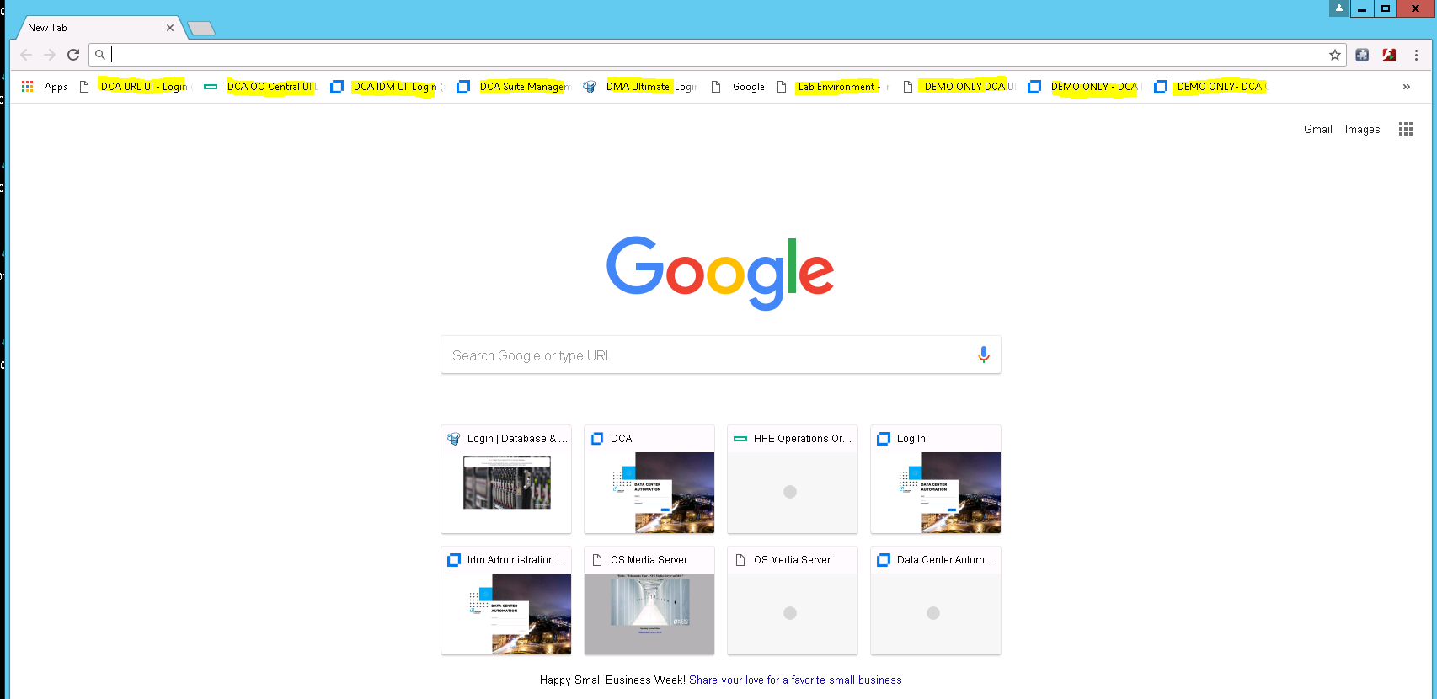
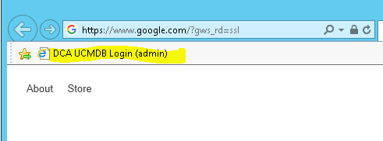
  These URL Favorites – Ready in Chrome and IE (4)
We have given you all the URL’s required for most demos.
Please Use Chrome for DCA and DMA
Please Use IE for UCMDB

Slide 25
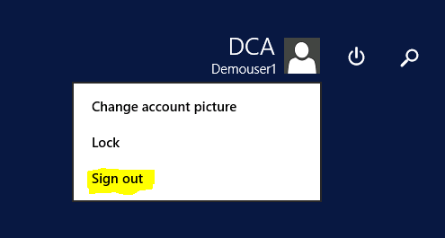
  * IMPORTANT* - When you are finished for the day (5)
When you are finished for the day, or still wish to come back to the clientapps01 server during your demo reservation– Please Sign Out! This will clean-up your running windows will be closed.
Even if you plan to come back within a few hours, best to sign out and come back to a clean desktop!
This will make it a cleaner environment for the next person.
✓
DO THIS!
DO NOT SHUTDOWN/REVERT the clientapps01 server – others are using it!

Slide 26
  * IMPORTANT* - When you finish your Demo (6)
When you wish to close the clientapps01 at the end of your demo/demo reservation – Please Sign Out! This will clean-up your running windows will be closed.
BEFORE YOU GO!
Please clean-up all your SA Managed servers by:
Remove servers from DCA Resource Groups
Deactivating the SA Agent,
Power off and then
Delete the VMS!
This will make it a cleaner environment for the next person.
✓
DO THIS!
DO NOT SHUTDOWN/REVERT the clientapps01 server – others are using it!

Slide 27
What is on your Desktop?

Slide 28
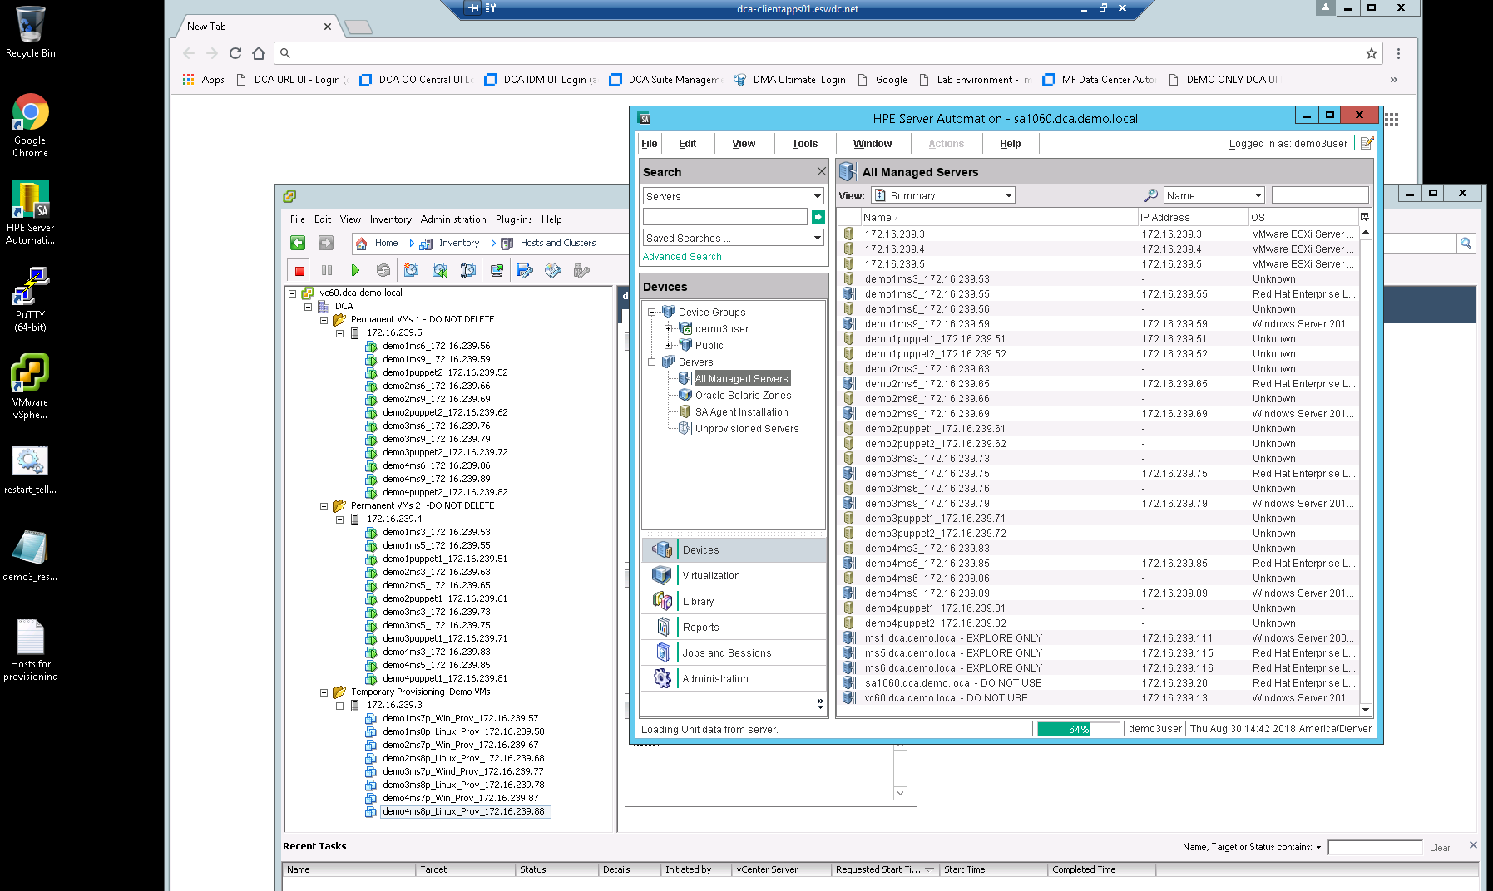
What is on the Desktop

Slide 29
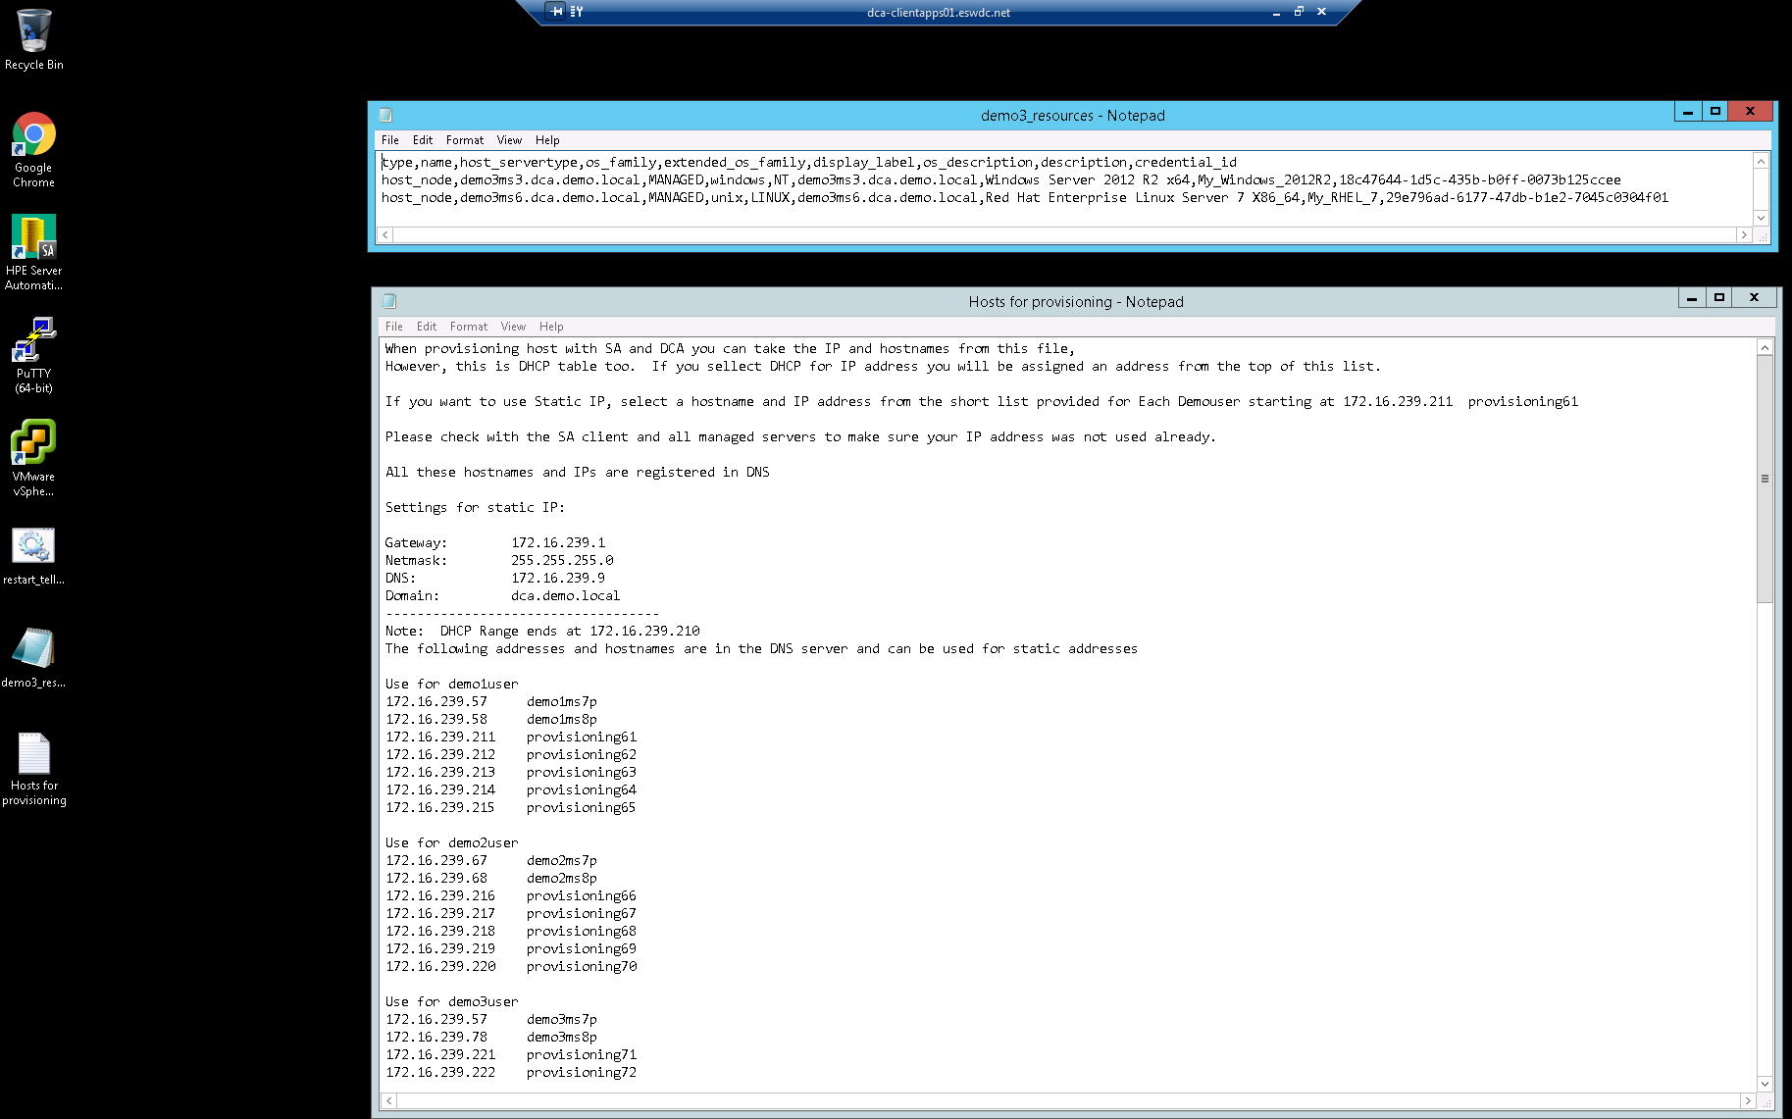
What is on the Desktop (2)

Slide 30
Login to Shared vCenter vSphere Client
TOC

Slide 31

  Careful working in the vSphere Client!
You have been given permission to access the Shared Demo vCenter vSphere Client
Remember what you do in the vCenter could have repercussions on others using the Shared Demo Lab.
Please DO NOT delete, modify, or stop any of the “Shared” resources.
Only make changes to YOUR vms!
Please DO NOT ABUSE YOUR PRIVILEDGE!
If people will not play fair in the vCenter we will remove this feature!

Slide 32
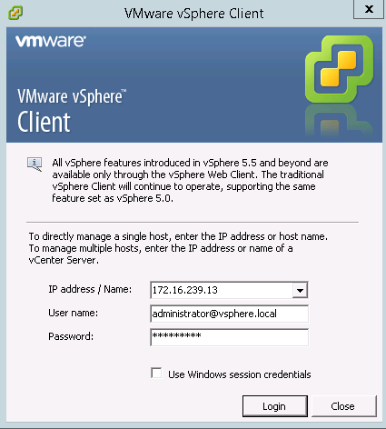

  Login to the Shared vCenter vSphere Client
From the Accessvm Session open the VMware vSphere Client to:
      172.16.239.13
Note: This link can be found on your desktop!
Login: administrator@vsphere.local
Password: Admin@123

Slide 33
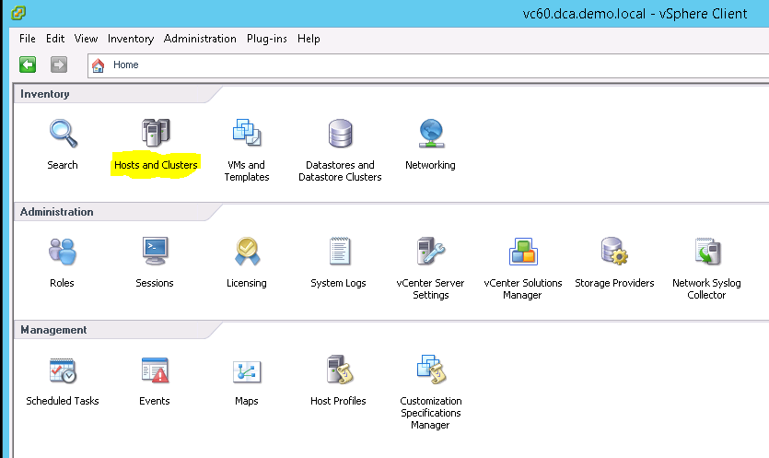
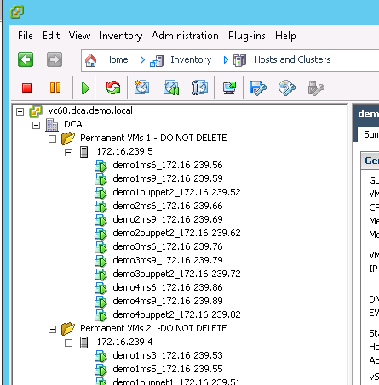
  Access VMs in vCenter vSphere Client
Click on Hosts and Clusters to access shared VMS and manage their state.

Slide 34
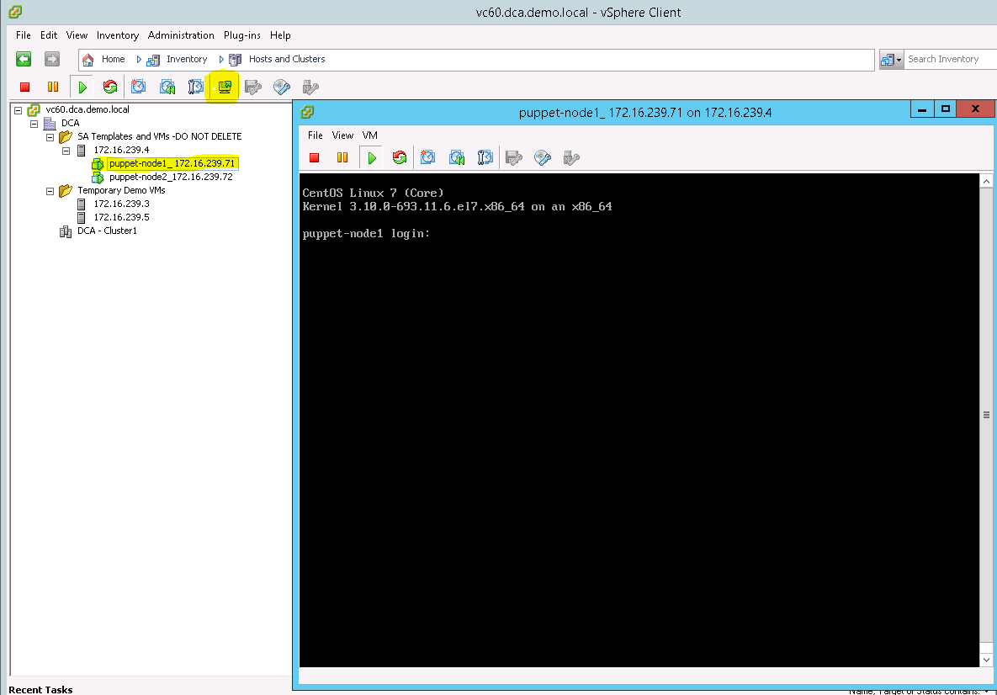
  View a VM’s Console
Single Click a VM. Single Click the Console Icon. Expand console to Fit Window to Guest. Single click in Console to access.
To login to Windows server send a Ctrl-Alt-Del
To temporarily exit and Console and return back to the accessvm hit Ctrl-Alt

Slide 35
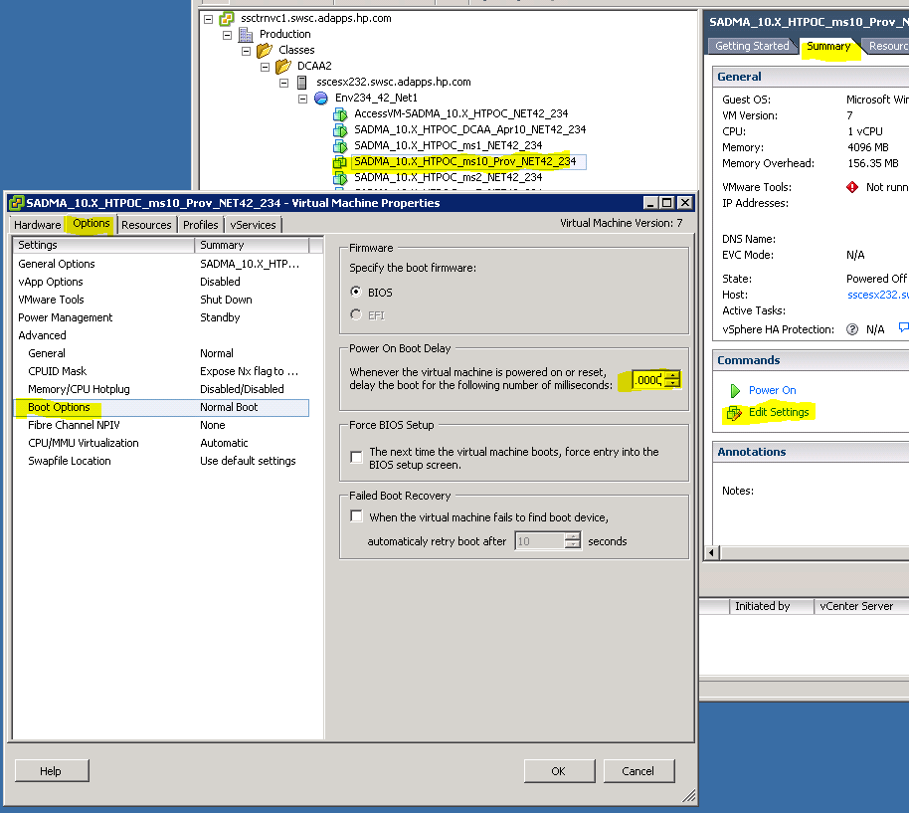
  Change VM’s Boot Delay Options (optional)
To adjust the boot delay for a vm open the Summary, Edit Settings, go to Options and Boot Options. Turn delay to 10,000 ms
This will be useful when you start to boot vms for OS Provisioning. Allows you time to select correct OGFS Build Agent.
Note: It will be reset to default value if you revert the vm. You will need to change again!

Slide 36
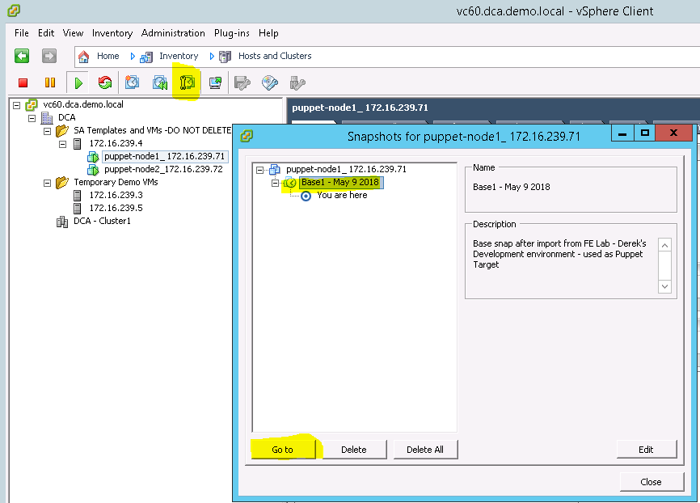
  Revert a VM back to start of class
Single Click a VM. Single Click the Snapshot Manager icon. Single click the first snapshot saved. Click Go to
Power on the VM once the snapshot has been reverted

Slide 37
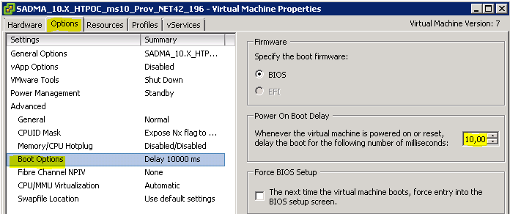
  Guidelines using vSphere Client and VMs
Please ONLY USE vSphere Client to:
  Create a VM
  Snapshot YOUR VMs
  Revert VMs back to the start of the demo settings
  Start VM
  View VM Console for interaction with boot process (OS Provisioning)
  Change boot settings
PLEASE PLAY FAIR in your environment!
Any changes to the shared environment could have consequences for others.
Please Do Not Abuse your lab privileges!

Slide 38
DCA Suite Demo Use Cases

Slide 39


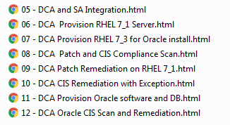
Executive Demos – DCA Suite Reference
The following can be used as a guideline working the lab environment!
Some of these show setup tasks which do not
need to be performed – reference only:
DCA Puppet Integration and Compliance
DCA Agentless management
SA Integration
  SA Integration and SA Server Management
  OS Provisioning
  Patching
  Compliance
  Oracle Server Provisioning
  Oracle Compliance

Slide 40
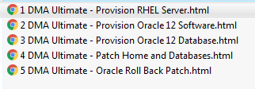
Executive Demos – DMA Ultimate Reference
The following can be used as a guideline working the lab environment!
These set of Executive Demos show how too use DMA Ultimate to:
Create a target RHEL server
Provision Oracle 12 Software
Provision a Database
Patch Home and Database
Roll Back Patch
Note: These were done using DMA 10.50

Slide 41
Lab Use Case Recommendations
Here are some guidelines in using the DCA Shared Demo Lab:
Stick to RHEL 7.3 for provisioning, patching and compliance
Use the Meltdown and Spectre Patch policies, Poodle does not require patch so always compliant
Avoid Windows provisioning – takes a long time, but if you do, use W2K12R2 or W2K16
Both demoXms5 and demoXms6 can be use for Oracle/JBOSS provisioning with DMA Ultimate
Both demoXms3 and demoXms9 can be used for MS SQL provisioning with DMA Ultimate
Avoid using the DCA Templates for Oracle and MS SQL, but use for Linux and Windows Provisioning
For Puppet Managed servers, run DCA compliance on the CentOS (demoXpuppet1) servers. RHEL has bug right now (August 30, 2018 – being worked on)
Do create your own Resource Groups for Oracle and MS SQL to show Middleware Compliance

Slide 42
Troubleshooting Resources!

Slide 43
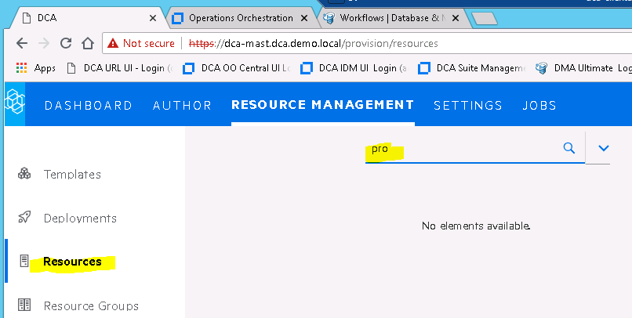

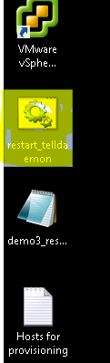
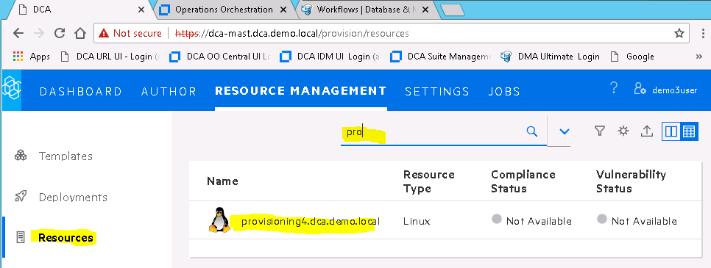
A new SA provisioned server not in DCA Resources
Note: This can happen if the telldaemon does not update the UCMDB. We need to “kick-start” it!
Resource in SA, not DCA
From Desktop
Run the restart_telldaemon script to stop and restart the telldaemon
Wait a few minutes…..

Slide 44
How to Delete a Server from UCMDB
Note: This ONLY applies to servers which were imported into DCA via CSV file. This is NOT for SA Integrated Servers.
Login to the UCMDB from IE Note: DO NOT USE CHROME!
https://dca-pocapp-mast.dca.demo.local:33111/ admin=Automation.123

Slide 45
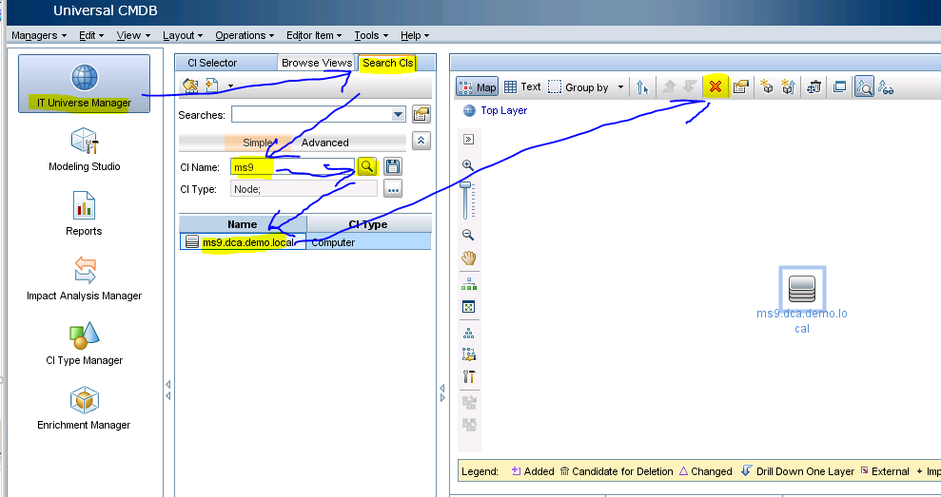
How to Delete a Server from UCMDB
Open the IT Universe Manager and search for your server. Then delete!

Slide 46
Questions?

Slide 47

Questions?
If you have questions using this shared demo lab please email: hayden.brown@microfocus.com

